Slide 1
Developing an Educational Web Application for Student Training in Geographical Information Systems (GIS)
2019
Disaiah Bennett, Edsel Norwood, Derek Morris Jr.
Elizabeth City State University

Slide 2
Abstract
Geographic Information Systems (GIS) and Remote Sensing is an industry with a high workforce demand and even higher environmental importance. There are many programs in which young adults are introduced to classes/careers that, otherwise may not come into contact with. It’s these types of programs that expose young adults to the open possibilities and career paths that lay ahead of them, and in doing so these young adults are given a chance to discover their passions, and plan the rest of their academic careers accordingly. It was for this reason that we felt that the training modules within the GAIA Crossroads textbook needed to be updated to take a more modern approach.

Slide 3
What is GIS?
GIS manages and analyze data, and can determine patterns, relationships, and situation that help users make intellectual decisions. GIS enhance the way people modify and approach geographic information such as maps. People been using GIS maps for numerous of years. GIS maps helps users exploit their work and organization on the internet. Maps gives a basic setting since they are both creative and analytical. They sustain a general appearance, coherence, and structure to the world. Maps enable you to explore your information and to uncover and clarify patterns. “GIS allows students to collect and visualize authoritative data about the question of interest, adding their own data to the map before performing a wide range of analyses on the data in question.”

Slide 4
Who uses GIS tools?
Geographical Imagery Systems (GIS) are used in hundreds of ways in today's world. Schools across the world use GIS in ways that enhance the learning environment, such as creating interactive maps that help students better understand subjects as math, environmental science, and history. The use of GIS related tools and resources so teachers can better help students improve “spatial analysis and critical-thinking skills” that “prepare young minds to succeed in course work, further education, and life”. GIS is also used in a wide range of fields such as health, government, and telecommunications.

Slide 5
Teaching with GIS and Remote Sensing/Geoscience
Teaching with GIS “allows geoscience students to work directly with data in the field and classroom and to develop and refine their spatial reasoning skills.” By integrating GIS into geoscience courses, students are presented an opportunity to perceive the data being constructed from the environment around them as well as establish the correlations between the data and reality.

Slide 6
Methodology
When a user uses the web GIS, it will allow the user to share data universally; in addition, GIS provide usage and access of their tools on smartphones and tablets. With the use of the web-based GIS tools, the already established education for individual classes are able to be provided for students in K-12. Preparing students for early college with the assistance of GIS, introduces the students to more STEM related areas of research, and provides a higher awareness of these subjects. The tools that have been applied have been shown to not only “enhance teacher awareness”, but also “allow them to best communicate and demonstrate geographical awareness and capabilities that even simple spatial analysis might bring about topics dealing with population, history, and other areas.”

Slide 7
Website
To make it user friendly for both teachers and students
Modernize the pre-existing tutorials to better fit today’s technology

Slide 8
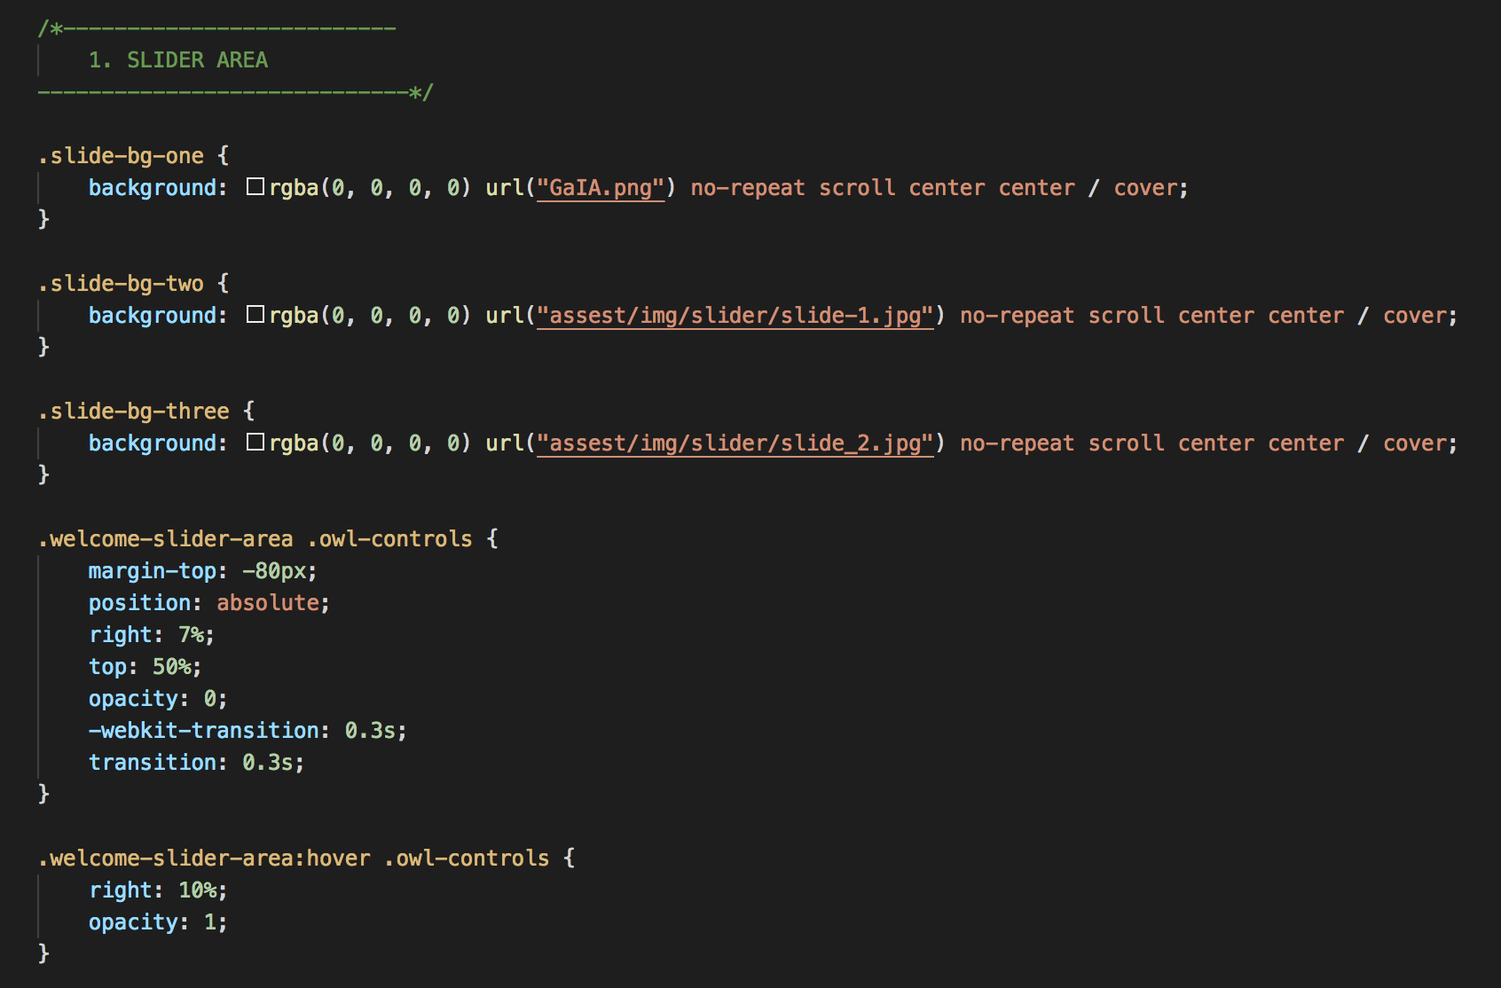
The Code
The code featured here is contained in the style.css file. CSS is used to define styles within web pages, including design, layout and variations in display for different devices and screen sizes. Condensing all of these attribute settings into a single file helps keep everything organized.

Slide 9
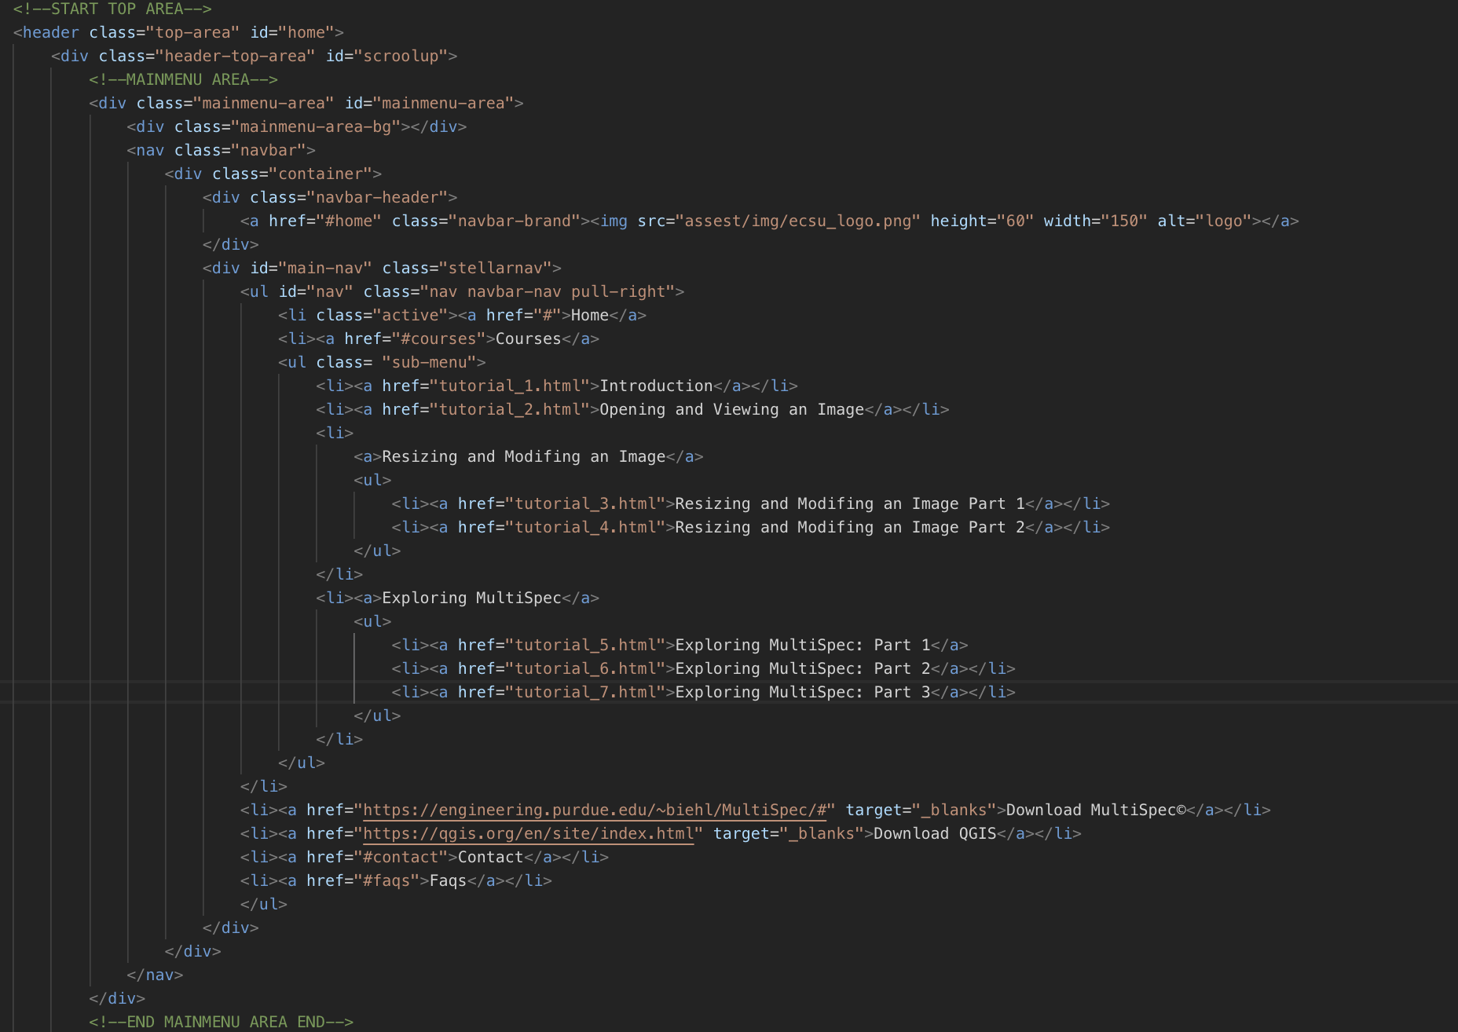
The Code contd.
This partial piece of code refers to the menu bar located at the top of the webpage. This contains the “Courses” tab which houses the links for each individual tutorial. It also contains links to download MultiSpec and QGIS, both of which are required for the tutorials.

Slide 10
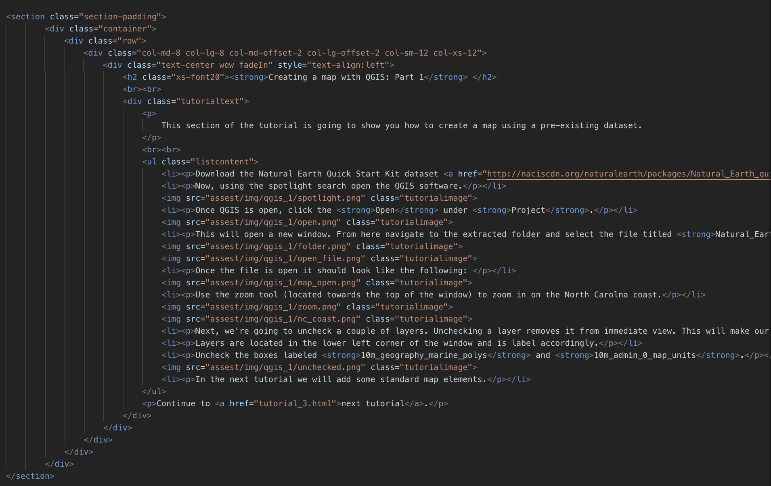
The Code contd.
The following is code pertaining to one of the QGIS tutorials.

Slide 11
Multispec
MultiSpec is a processing system for analyzing and interacting with Earth observational multispectral image data. Developed by Purdue Research Foundation, the overall objective is to act as an aid to export the results of research and devise good methods for analyzing such hyperspectral image data.
Download: https://engineering.purdue.edu/~biehl/MultiSpec/index.html

Slide 12
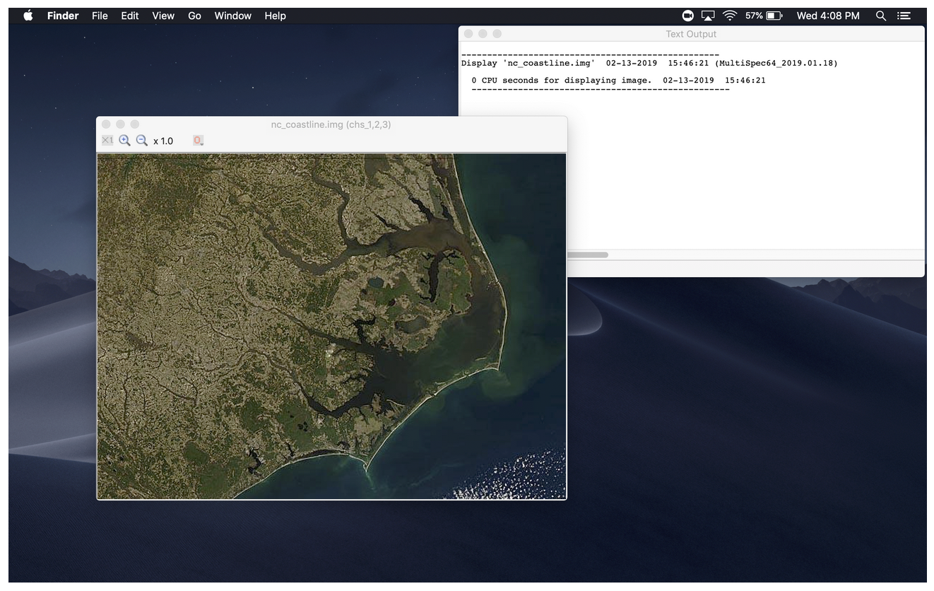
Multispec contd.
Opening an image in MultiSpec is fairly simple, although MultiSpec only accepts images/files with a specific file extensions. Some of these extensions include
.img
.lan
.tif
.bil.
Once an image has been opened, the user can run various processes to output various pieces of data.

Slide 13
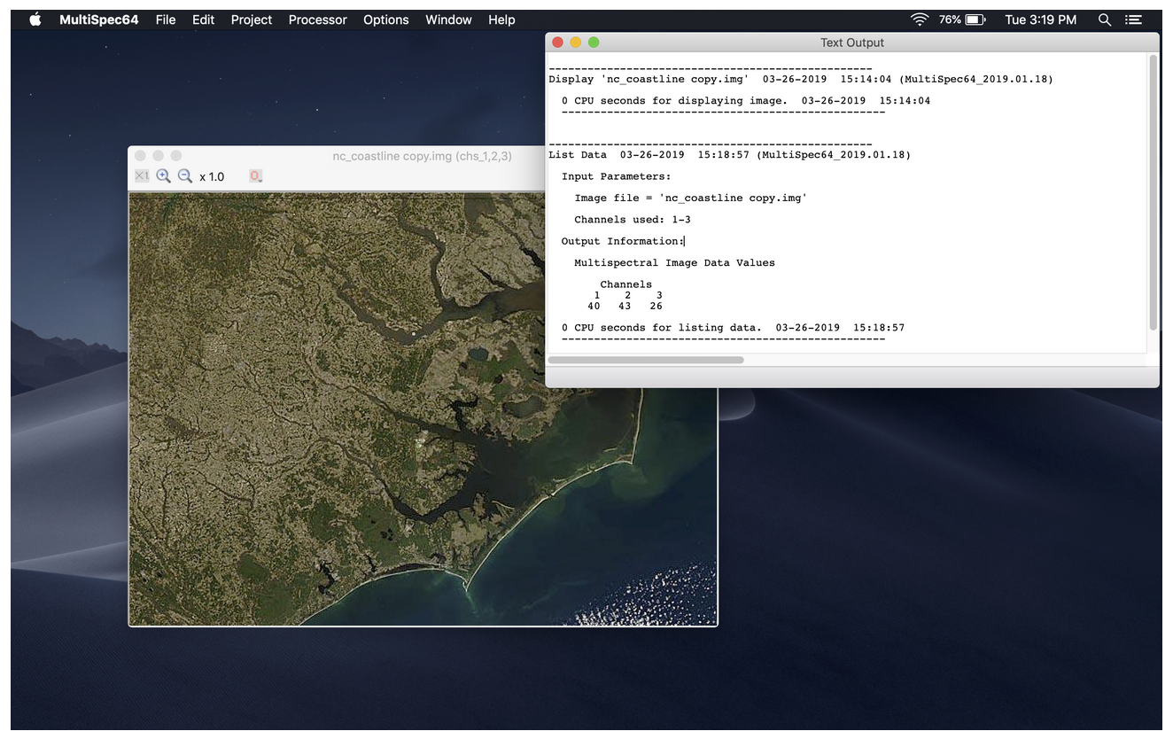
Multispec contd.
One of the processes a user can run is the List Data process. This will list the classification results of the specified areas in tabular form on a per field, per class, or groups of classes basis.

Slide 14
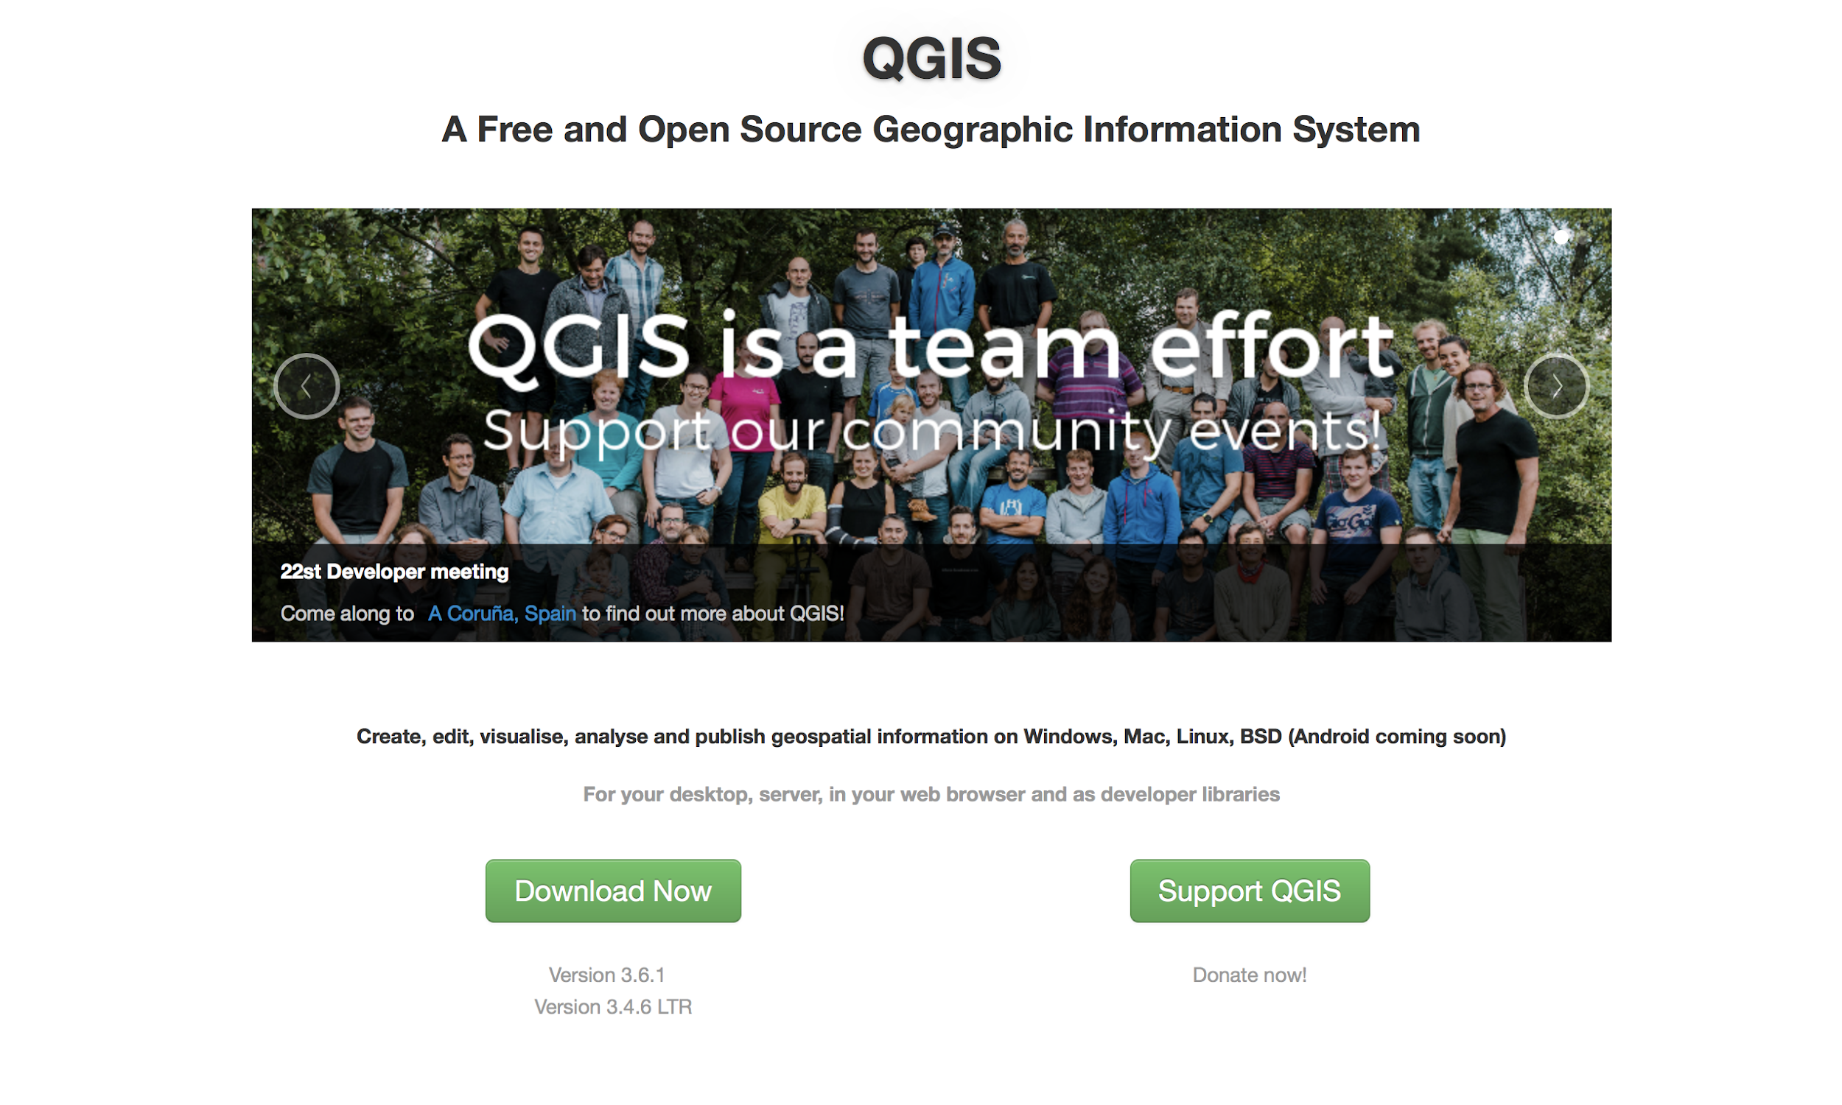
Quantum Geographic Information System (QGIS)
QGIS is a free and open-source cross-platform desktop geographic information system application that supports viewing, editing, and analysis of geospatial data.
Download: https://qgis.org/en/site/forusers/download.html

Slide 15
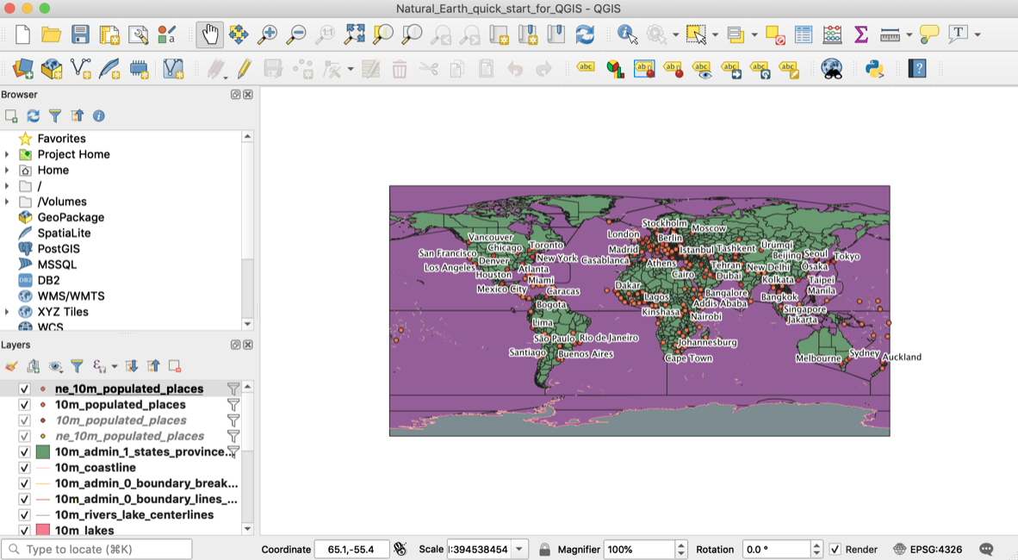
QGIS contd.
QGIS allows data to be imported and placed within a map. The data can be read from a .qgs file, which is the standard file format utilized by QGIS.
Once the data has been processed by the software, the user can zoom into any area on the map and move around the plotted datasets.

Slide 16
HTML
Hypertext Markup Language (HTML) is the framework for labeling content documents to achieve font, color, graphic and hyperlink effects on Internet pages. HTML is used to make website pages. The Web browsers can read HTML records and create them into visible or audible web pages. The browsers do not show the HTML labels and scripts, but utilize them to interpret the substance of the page.

Slide 17
JavaScript
JavaScript is a cross-platform scripting program that provides web pages with interactivity on most browsers. It was originally developed under the name LiveScript by Netscape. JavaScript is an object-oriented language with detailed scripting codes. As with other programming languages, JavaScript has certain key concepts and phrases that control the interaction with the web page.

Slide 18
The Website
https://cerser-gaia.github.io/

Slide 19
Future Work
Survey
Gain resulting data from teachers and students about the website efficiency.
Implementing a challenge system
Based upon the completion of the tutorials, the students will receive a online certificate.
Constructing a user database (SQL)
Store the user’s data when implementing the challenge system.
Phone Application
Making the website more compatible with different device platforms.
Maintaining the website
Tutorial updates, and security optimization.

Slide 20
References
[1]M. Altaweel, "Teaching GIS in Elementary School", GIS Lounge, 2019. [Online]. Available: https://www.gislounge.com/teaching-gis-elementary-school/.
[2]Esri.com, 2019. [Online]. Available: https://www.esri.com/library/ebooks/advancing-stem-education-with-gis.pdf.
[3]"Inspire: Linking graduate students with K12 teachers to address remote sensing educational needs - IEEE Conference Publication", Ieeexplore.ieee.org, 2019. [Online]. Available: https://ieeexplore.ieee.org/document/6945948?tp=&arnumber=6945948&queryText%3Dms%20karen%20warrington=v.
[4]D. Butler and S. Bednarz, ""Mission Geography" and the use of satellite imagery in K-12 geographic education - A NASA - GENIP partnership", https://www.researchgate.net/, 2019. [Online]. Available: https://www.researchgate.net/publication/249044868_Mission_Geography_and_the_use_of_satellite_imagery_in_K-12_geographic_education_-_A_NASA_-_GENIP_partnership.
[5]"ERIC - Education Resources Information Center", Eric.ed.gov, 2019. [Online]. Available: https://eric.ed.gov/?id=EJ1115876 -> https://files.eric.ed.gov/fulltext/EJ1115876.pdf.
[6]"GIS and Remote Sensing", GIS and Remote Sensing, 2019. [Online]. Available: https://serc.carleton.edu/NAGTWorkshops/gis/index.html.

Slide 21
References contd.
[7]Pdfs.semanticscholar.org, 2019. [Online]. Available: https://pdfs.semanticscholar.org/a691/303ad2d0f30ab92d819bd86e113ac5ab20b4.pdf.
[8]"GIS Education | Mapping & Spatial Analytics for Schools, Higher Education & Lifelong Learning", Esri.com, 2019. [Online]. Available: https://www.esri.com/en-us/industries/education/overview.
[9]"What is GIS? | Geographic Information System Mapping Technology", Esri.com, 2019. [Online]. Available: https://www.esri.com/en-us/what-is-gis/overview.
[10]"Geographic Information Systems (GIS)", Cityofec.com, 2019. [Online]. Available: https://www.cityofec.com/?SEC=5C759CFE-FBC1-46B3-80CB-ABB26AD42D1A.
[11]"SAGE Journals: Your gateway to world-class journal research", Journals.sagepub.com, 2019. [Online]. Available: https://journals.sagepub.com/doi/10.3102/0002831207308221.
[12]“What Is Remote Sensing and What Is It Used for?”, USGS, 2019, [Online]. Available: https://www.usgs.gov/faqs/what-remote-sensing-and-what-it-used?qt-news_science_products=7#qt-news_science_products.
[13]”Remote Sensing”, earthobservatory.nasa.gov, 2019, [Online]. Available: https://earthobservatory.nasa.gov/features/RemoteSensing.

